Slide 1

Fatigue Analysis
Week 3:
Fatigue Analysis Problem Set
Mechanical Engineering
Team Plan B
Austin Dionne
Greg Hovagim
Carlos Lazo (Team Lead)
Nate Soule

Slide 2
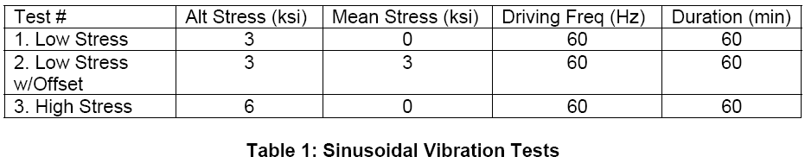



Problem 1 – Sinusoidal Vibration and CDI
Evaluated the fatigue characteristics of the G10 circuit board
Performed analysis on three tests applying sinusoidal vibration
Required Number of Cycles
Fatigue Strength Coefficient
Fatigue Strength Exponent

Slide 3

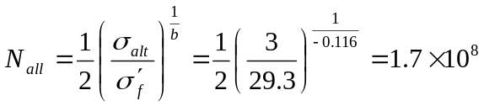

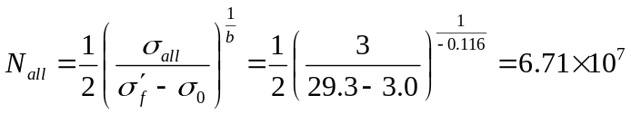



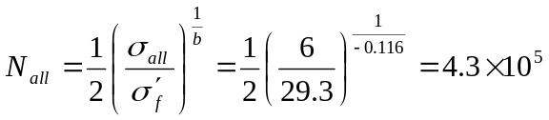



Problem 1 – Results
Test 1
Alternating Stress
Test 2
Alternating Stress
Number of Allowable Cycles
Mean Stress
Allowable Number of Cycles
Damage Index
Damage Index
Test 3
Alternating Stress
Overall
Cumulative Damage Index
Allowable Number of Cycles
Damage Index
The G10 board will survive the tests.

Slide 4
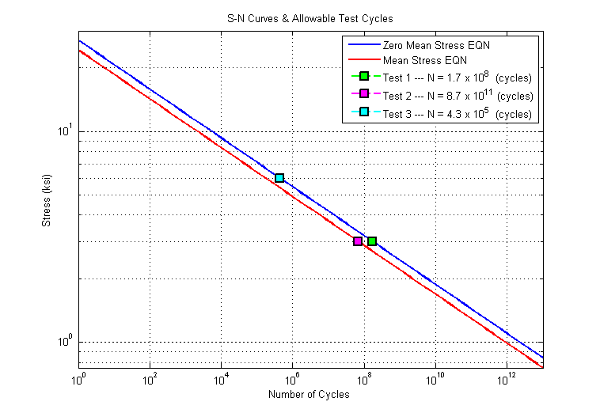
Problem 1 – S-N Curve

Slide 5
Problem 1 – Effects of Applying a Mean Stress
Conclusion:
Applying a equivalent mean stress did not make a significant difference in the damage index.
example: screwing a PCB to stand-offs
Doubling the alternating stress caused a very significant difference in the damage index.
example: Tacoma Narrows Bridge

Slide 6
Problem 2 – CTE Mismatch and Low Cycle Fatigue
Currently the G10 circuit board and attached components have significantly different CTEs.
This difference may cause damage at solder joints during thermal expansion.
We evaluated the current design and propose a change to the PCB that would reduce the potential for damage.

Slide 7

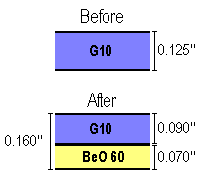




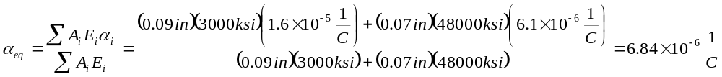
Problem 2 – Part A – CTE Mismatch and Low Cycle Fatigue
Properties of G10
Coefficient of Thermal Expansion
Selected Thickness of Layers
Modulus of Elasticity
Properties of Leadless Component
Coefficient of Thermal Expansion
Properties of BeO 60
Coefficient of Thermal Expansion
Modulus of Elasticity
New Equivalent Coefficient of Thermal Expansion

Slide 8
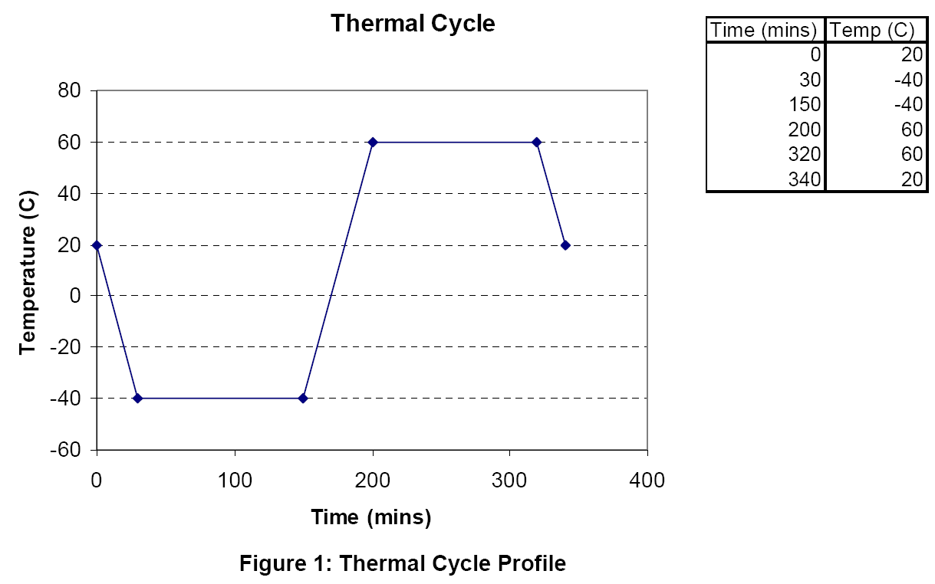





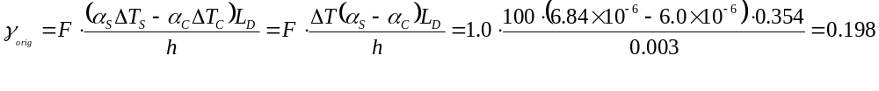
Problem 2 – Part B – CTE Mismatch and Low Cycle Fatigue
Temperature Change
We assume that change in temperature is the
same for the board and component
Empirical Non-Ideal Factor
Solder Joint High
Component Dimensions
½ Max Solder Joint Distance
Original Design
Shear Strain
Modified Design
Shear Strain

Slide 9




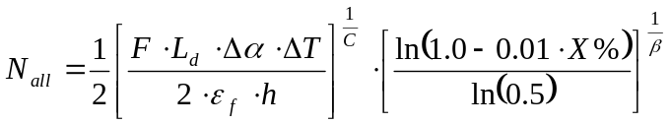
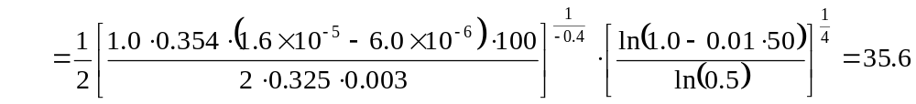
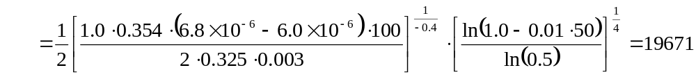
Problem 2 – Part C – CTE Mismatch and Low Cycle Fatigue
Fatigue Ductility Component
Weibull Shape Parameter
Acceptable Cumulative Failure Probability
Fatigue Ductility Exponent
Original Design
Allowable Number of Cycles
Modified Design
Allowable Number of Cycles
The modified board is able to survive more cycles, but is thicker and because it has multiple epoxies it will be more complicated and expensive to produce.

Slide 10
Problem 2 – Part D – CTE Mismatch and Low Cycle Fatigue
Suggestion for further improvement:
Use leaded components to reduce solder joint stress
Consider the effects on the thermal dissipation
Use thermal padding beneath component

Slide 11





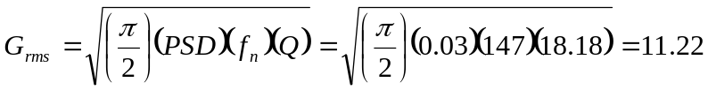


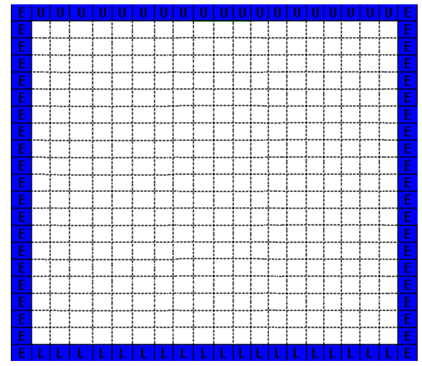






Problem 3 – Part A – High Cycle Fatigue
Length of Board*
Allowable Board Deflection at 10x10⁶ Cycles
*The length used is 2x the actual to accommodate for the non-simply supported side.
Length of Component
Transmissibility
Component Type Factor
Root Mean Square Acceleration
Board Thickness
Component Position Factor (Center of Board)
Root Mean Square Deflection
Sine to Random Conversion Factor (Solder (63-37))
Stress Concentration Factor
Slope of S-N Curve
Number of Positive Non-Zero Crossings per Second

Slide 12
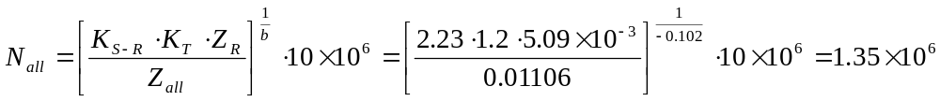



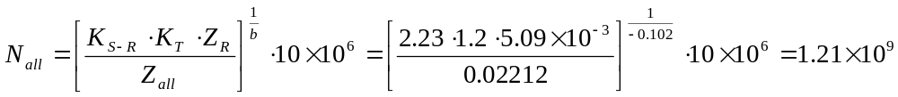

Problem 3 – Part A, B – High Cycle Fatigue
Allowable Number of Cycles
Cumulative Damage Index
For this placement the component will not remain intact throughout the test.
Component Position Factor (¼X, ¼Y)
Allowable Board Deflection at 10x10⁶ Cycles
Allowable Number of Cycles
Cumulative Damage Index
89602.5% Improvement
Repositioning the component made a significant difference and it will remain intact throughout the test.

Slide 13
Problem 3 – Part C – High Cycle Fatigue
Suggestion for board designer:
Place components along the edge of the PCB to minimize high cycle fatigue
This coincides with other suggestions for thermal design, because thermal dissipation was more difficult in the center of the board.

Slide 14





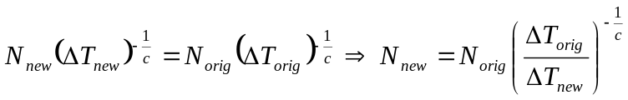
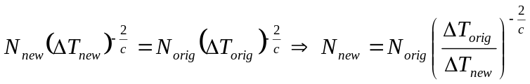
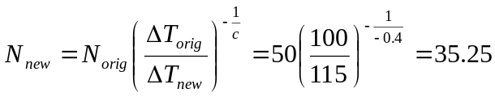
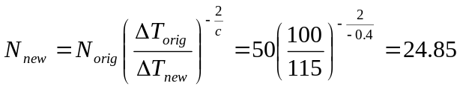
Problem 4 – Part A – Time Compression
Original Temperature Range
Original Number of Cycles
Time per Cycle
New Temperature Range
Fatigue Exponent
Leadless Components
Time Compression Relation
Leaded Components
Time Compression Relation
New Number of Cycles
New Number of Cycles
Improvement (Cycles)
Improvement (Cycles)
Improvement (Minutes)
Improvement (Minutes)

Slide 15




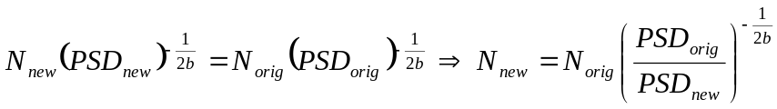
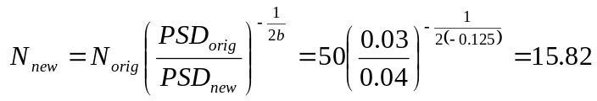

Problem 4 – Part B – Time Compression
Original Power Spectral Density
New Power Spectral Density
Original Number of Cycles
Time per Cycle
Fatigue Exponent
Time Compression Relation
New Number of Cycles
Improvement (Cycles)
Improvement (Hours)

Slide 16
Problem 4 – Part C – Time Compression
Warning about time compressing tests:
“Most often designs are constructed of many different materials having a variety of fatigue slopes. Thus, for a given time compression some components of the design will be over test while others will be under tested.”
- Fatigue Analysis Course Book

Slide 17
¿QUESTIONS?

